Slide 1
The STI Cell Processor
Kathy Yelick
yelick@cs.berkeley.edu
www.cs.berkeley.edu/~yelick/cs194f07
With lots of help from Sam Williams

Slide 2
Outline
Memory Models
  Cache
  Scratchpad / Local store
Cell Hardware
Threading Model
Addressing Model
Introduction to Cell DMA
Stencil Example

Slide 3
Caches
Sits between the registers and DRAM
DRAM lines are copied(and tagged) into cache
Contents are aliased to DRAM
Kept coherent with DRAM
Invisible to the programmer (hardware handles everything)
For some programs, reduces memory access time
HW prefetchers can detect miss patterns and pre-place data in the cache before its needed.
If the data isn’t present when its accessed, the processor will stall until it is.

Slide 4
Scratchpad (Local Store)
Sits between the registers and DRAM
DRAM lines are copied into the local store
Forms a disjoint address space (not aliased)
Not kept coherent with DRAM
Explicitly controlled by the programmer
DMA engines can be programmed to pre-place data into the local store before its needed.
If the data isn’t present when its accessed, the program is wrong.

Slide 5
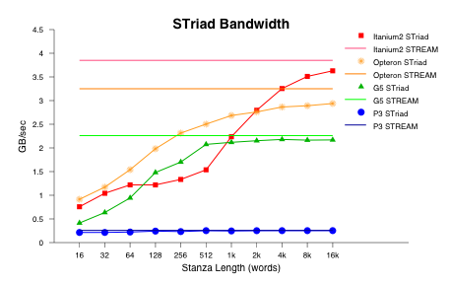
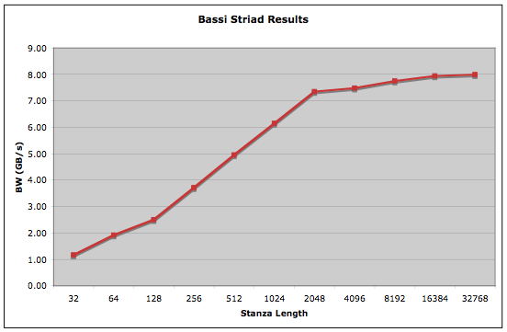
Prefetch vs. Explicit DMA
Perfect prefetching:
  performance is independent of L, the stanza length
  expect flat line at STREAM peak
  our results show performance depends on L because of prefetch effects
Cell “explicit DMA”
  For well-understood (predictable) prefetch patterns, Cell can provide nearly flat response (nearly full memory system performance) for memory accesses because the bulk memory requests are explicit! (no need to game the prefetch engines!)
  Cell memory requests can be nearly completely hidden behind the computation due to asynchronous DMA engines
  Performance model is simple and deterministic (much simpler than modeling a complex cache hierarchy), min{time_for_memory_ops, time_for_core_exec}

Slide 6
Cell Hardware

Slide 7
Overview
Each Cell chip has:
  One PowerPC core
  8 compute cores (SPEs)
  On-chip Memory controller
  On-chip I/O
  On-chip network to
  connect them all
A Blade has
  2 Cell Chips
  Each with 512MB of XDR
A PS3 has
  1 Cell Chips (6 usable SPEs)
  256MB of XDR DRAM Memory
PowerPC
SPE
SPE
SPE
SPE
On-chip Network
I/O
SPE
SPE
SPE
SPE
Memory
Controller
25.6GB/s
512MB XDR DRAM

Slide 8
PowerPC Core (PPE)
3.2GHz
Dual issue, in-order
2-way vertically-multithreaded
512KB L2 cache
No hardware prefetching
SIMD (altivec) + FMA
6.4 GFlop/s (double precision)
25.6 GFlop/s (single precision)
Serves 2 purposes:
  Compatibility processor;
    runs legacy code, compilers, libraries, etc.
  Performs all system level functions
    including starting the other cores
PowerPC
SPE
SPE
SPE
SPE
On-chip Network
I/O
Memory
Controller
SPE
SPE
SPE
SPE
25.6GB/s
512MB XDR DRAM

Slide 9
Synergistic Processing Element (SPE)
Offload processor
Dual issue, in-order, VLIW inspired SIMD processor
128 x 128b register file
256KB local store, no I$, no D$
Runs a small program (placed in LS)
Offloads system functions to the PPE
MFC (memory flow controller)
  a programmable DMA engine and on-chip network interface
Performance
  1.83 GFlop/s (double precision)
  25.6 GFlop/s (single precision)
  51.2GB/s access the local store
  25.6GB/s access to the network
PowerPC
SPE
SPE
SPE
SPE
On-chip Network
I/O
Memory
Controller
SPE
SPE
SPE
SPE
25.6GB/s
512MB XDR DRAM
SPU
128x128b Register File
Even Pipe
FP, integer,
bitwise, …
Odd Pipe
load/store,
permute,
channel,
branch
Instruction buf & Control
16B/core cycle
256KB Local Store
128B/core cycle
MFC (DMA+Network Interface)
16B/bus cycle
16B/bus cycle

Slide 10
Element Interconnect Bus (EIB)
4 x 12 node rings
2 clockwise, 2 counterclockwise
Allows:
  PPE access to DRAM, I/O, and SPEs
  SPEs access to DRAM, I/O, PPE, and other SPEs
Each node can read/write 16Bytes @ 1.6GHz
Multiple simultaneous transfers
Scheduled block access
PowerPC
SPE
SPE
SPE
SPE
On-chip Network
I/O
Memory
Controller
SPE
SPE
SPE
SPE
25.6GB/s
512MB XDR DRAM

Slide 11
DRAM Memory
XDR based
25.6GB/s
DMA based accesses are long blocks and deliver > 22GB/s
Cache+SW prefetch delivers<5GB/s
PowerPC
SPE
SPE
SPE
SPE
On-chip Network
I/O
Memory
Controller
SPE
SPE
SPE
SPE
25.6GB/s
512MB XDR DRAM

Slide 12
Threading Model

Slide 13
Threading
For each SPE program the PPE will run, it must:
  Create a SPE context
  Load the SPE program (embedded in the binary)
  Create a pthread to run it
Each pthread can be as simple as:
  spe_context_run(…);
  pthread_exit(…);
Typically, split the work into 2 phases:
  Code that runs on the SPEs
  Code that runs on the PPE
with a barrier in between
Create
pthreads
SPE
program
SPE
program
SPE
program
Barrier()
Barrier()
Barrier()
Barrier()
Barrier()
SPE
phase
SPE
phase
SPE
phase
Barrier()
Barrier()
Barrier()
PPE
phase
Barrier()
Barrier()
Barrier()
Barrier()
…
Join
pthreads

Slide 14
Thread Communication
The PPE (PowerPC core) may communicate with the SPEs via:
  individual mailboxes (FIFO)
  HW signals
  DRAM
  Direct PPE access to the SPEs’ local stores

Slide 15
Addressing Model

Slide 16
PPE Address types
PPE pointers point to global (DRAM addresses)
They are referenced as usual, and the locations are cached and kept coherent with other PPEs
However, all local stores can be aliased to the DRAM address space.
  So the PPE can create a pointer to a SPE’s local store, and apply an offset for addressing any location in any SPEs local store as if it were DRAM.
  These addresses are not cached (no coherence issue)
PowerPC
(PPE)
PowerPC
(PPE)
SPE
SPE
SPE
SPE
$
$
Local
Store
Local
Store
Local
Store
Local
Store
Shared off-chip DRAM

Slide 17
SPE Address types
SPE pointers only point to local store addresses
Loads and stores can only access this SPEs LS
DRAM addresses are treated as 32 or 64b integers.
  The PPE must pass (on invocation, or by mailbox) the relevant DRAM addresses.
  All other SPEs’ LS are aliased to the DRAM space
  So given the 64b DRAM address, an SPE can construct a DRAM address to any location in any other SPE
  However, all DRAM addresses can only be accessed via DMA put and get, not Load and Store instructions.
PowerPC
(PPE)
PowerPC
(PPE)
SPE
SPE
SPE
SPE
$
$
Local
Store
Local
Store
Local
Store
Local
Store
Shared off-chip DRAM

Slide 18
Introduction to DMA on Cell

Slide 19
DMA introduction
There are 4 types of DMA commands:
  Get copies N bytes from a DRAM address to a local store address
  Put copies N bytes from a local store address to a DRAM address
  Get List copies i blocks of N_{i} bytes from DRAM address_{i}, and packs together starting at a local store address
  Put List unpacks i blocks of N_{i} bytes starting at a local store address and copies them to DRAM address_{i}
  Lists are limited to 2K x 16KB stanzas

Slide 20
DMA operation
DMA commands are queued via the channel (memory mapped I/O) interface within each SPE to each MFC.
Queuing is non blocking (but the queue can fill).
Each DMA can be tagged with an identifier.
You must wait for DMAs to complete before accessing the data they touched
Since they are in effect decoupled DRAM loads and stores, you may double buffer operations and overlap communication and computation

Slide 21
Stencil Example

Slide 22
Basic Stencil Code for 3D 7Point Stencil
void stencil3d(double A[], double B[],
int nx, int ny, int nz) {
for all i in x-dim {
for all j in y-dim {
for all k in z-dim {
B[center] = S0* A[i,j,k] +
S1*(A[i+1,j,k] + A[i-1,j,k] +
A[i,j+1,k] + A[i,j-1,k] +
A[i,j,k+1] + A[i,j,k-1]);
}
}
}
}
x
z (unit-stride)
y
Notes:
CODE FOR A 3-D OUT-OF-PLACE CODE
READING FROM A, WRITING TO B
Relatively straightforward

Slide 23
Naïve code?
Simple problem
  Heat equation on a regular grid (256³)
  7pt double precision stencil
  Jacobi (out of place)
You can’t just write a naïve version.
  Or it will only run on the PPE (PowerPC)
You must decide how to partition the work into chunks, bring them into the local store, process them, and write the result to DRAM.
We can rework the cache blocking technique into local store blocking.
Z
Y
X(unit stride)

Slide 24
Local Store Blocking
Naively, we must load 3 blocked planes, and store 1 blocked plane.
  As we loop in the Z dimension, entire planes can be reused
  So we can use a circular queue (next plane is enqueued, last plane is dequeued)
  We want to double buffer the computation and communication (so add an entry to each queue)
Assume we have 200KB(25K doubles) available
Each block has an implicit ghost zone surrounding it.
There is no RAW hazard as it is Jacobi
We need to keep 6 planes of size X+2 by YBlock+2
Solve for YBlock (~16)
Define 6 pointers to planes to form 2 queues:

Slide 25
SPE Program Structure
main(uint64_t Grid_t_global){
//read in grid structure (structure containing, pointers, paramaters, etc…
//compute the size of each LS block (based on X dimension)
// create read plane queue
volatile double * LocalGridZm1T = … //
volatile double * LocalGridZT = … //
volatile double * LocalGridZp1T = … //
volatile double * LocalGridZp2T = … // read into this,
// while computing on the others
// create write plane queue
volatile double * LocalGridZm1Tp1 = … // write this one back to DRAM
volatile double * LocalGridZTp1 = … // target for current stencil
// loop thru all time steps
for(time=0;time<TotalTime;time++){
BARRIER();
// loop through all cache blocks belonging to this SPE
for(y=YStarts[speRank];y<YStarts[speRank+1];y+=MaxCacheBlockY){
GridOffset = (MaxCacheBlockX+2)*y;
Process_CacheBlock(…);
}
BARRIER();
// let ppu do something
}
BARRIER();
return;
}
Z
X(unit
stride)
Y

Slide 26
Process one Cache Block
for(z=1;z<=(Grid.ZDim+1);z++){
// initiate DMA get for next plane in (create a list, queue and tag with buf^1)
// initiate DMA put for last plane out (create a list, queue and tag with buf^1)
// wait for previous DMA's (Zp1T, ZTp1)
DEBUG_WAIT_temp = spu_readch( SPU_RdDec );
mfc_write_tag_mask(1<<(buf));
mfc_read_tag_status_all();
DEBUG_WAIT_CYCLES += (DEBUG_WAIT_temp - spu_readch( SPU_RdDec ));
// Zm1T,ZT,Zp1T -> ZTp1
if(z<=Grid.ZDim)Process_Plane();
// swap pointers in circular Current queue
tempPtr = LocalGridZm1T;
LocalGridZm1T = LocalGridZT;
LocalGridZT = LocalGridZp1T;
LocalGridZp1T = LocalGridZp2T;
LocalGridZp2T = tempPtr;
// swap pointers in circular Next queue
tempPtr = LocalGridZm1Tp1;
LocalGridZm1Tp1 = LocalGridZTp1;
LocalGridZTp1 = tempPtr;
// invert tag for double buffered
buf^=1;
}
Z
Z
X(unit stride)
X(unit stride)
Y
Y

Slide 27
Process one Plane
Unlike the normal cached version, the Z+1, Z-1 planes are disjoint and cannot be indexed by adding the plane size.
Thus we have 4 disjoint planes:
  3 from the current time step that are read from (Z-1,Z,Z+1)
  1 for the next time step (at Z)
Sweep from y=1 to y=Yblock, and from x=0 to x=X+1 points in the plane, and perform the stencil operation

Slide 28
Parallelize
Distribute cache blocks among SPEs
Only need to specify first/last block
barrier() implemented with one uncached LS variable per SPE
When a SPE enters the barrier, it sets it.
When the PPE detects that all are set, it clears all of them (LS aliased to DRAM address space)
SPE3
SPE2
SPE1
SPE0

Slide 29
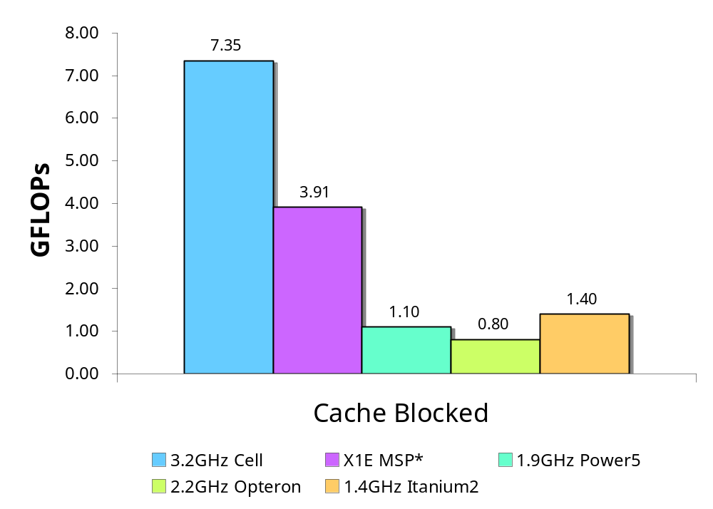
Performance

Slide 30
Extra Slides

Slide 31
Full Application
LBMHD
(this is not a toy)

Slide 32

LBMHD 3D
Navier-Stokes equations + Maxwell’s equations.
Simulates turbulence of high temperature plasmas (astrophysics and magnetic fusion)
Low to moderate Reynolds number
14
4
12
2
25
0
18
9
6
21
15
8
22
23
11
16
20
5
10
13
3
24
1
19
7
17

Slide 33
Data Structures
Must maintain the following for each grid point:
  F : Momentum lattice (27 scalars)
  G : Magnetic field lattice (15 cartesian vectors, no edges)
  R : macroscopic density (1 scalar)
  V : macroscopic velocity (1 cartesian vector)
  B : macroscopic magnetic field (1 cartesian vector)
Code performs 1238 flops per point
Good spatial locality, but 151 streams into memory (rolls the stream prefetch on most micros)

Slide 34
Gather/Scatter to Memory
F[:,:,:,:]
G[:,:,:,:,:]
Rho[:,:,:]
[0]
[1]
. . .
[26]
[2,12]
[2,13]
. . .
[2,26]
[1,12]
[1,13]
. . .
[1,26]
[0,12]
[0,13]
. . .
[0,26]
Local Store
Compute
[0]
[1]
. . .
[26]
[2,12]
[2,13]
. . .
[2,26]
[2]
[2]
[1,12]
[1,13]
. . .
[1,26]
[1]
[1]
Feq[:,:,:,:]
[0,12]
[0,13]
. . .
[0,26]
[0]
[0]
Rho[:,:,:]
B[:,:,:,:]
Geq[:,:,:,:,:]
V[:,:,:,:]

Slide 35
DMA List Creation
1
13
17
5
7
24
3
16
19
13[3]
17[3]
24[3]
16[3]
19[3]
+Plane
-Pencil
+Plane
+Plane
+Pencil
8
10
23
20
21
26
9
11
22
23[3]
20[3]
21[3]
26[3]
22[3]
-Pencil
0
+Pencil
0
12
15
4
6
25
2
14
18
12[3]
15[3]
25[3]
14[3]
18[3]
-Plane
-Pencil
-Plane
-Plane
+Pencil
z
x
y
Momentum Lattice
Magnetic Vector Lattice
YZ Offsets
Create a base DMA get list that includes the inherit offsets to access different lattice elements
  i.e. lattice elements 2,14,18 have inherit offset of:
  -PlaneSize +PencilSize
Create even/odd buffer get lists that are just:
  base + PencilY*PencilSize + PencilZ*PlaneSize
  just ~150 adds per pencil (dwarfed by FP compute time)
Put lists don’t include lattice offsets
Notes:
Look at this and say “glad I didn’t have to do that!”

Slide 36
DMA List Creation
1
13
17
5
7
24
3
16
19
13[3]
17[3]
24[3]
16[3]
19[3]
+Plane
-Pencil
+Plane
+Plane
+Pencil
8
10
23
20
21
26
9
11
22
23[3]
20[3]
21[3]
26[3]
22[3]
-Pencil
0
+Pencil
0
12
15
4
6
25
2
14
18
12[3]
15[3]
25[3]
14[3]
18[3]
-Plane
-Pencil
-Plane
-Plane
+Pencil
z
x
y
Momentum Lattice
Magnetic Vector Lattice
YZ Offsets
Create a base DMA get list that includes the inherit offsets to access different lattice elements
  i.e. lattice elements 2,14,18 have inherit offset of:
  -PlaneSize +PencilSize
Create even/odd buffer get lists that are just:
  base + PencilY*PencilSize + PencilZ*PlaneSize
  just ~150 adds per pencil (dwarfed by FP compute time)
Put lists don’t include lattice offsets
There will be a test on this immediately following the presentation.
Notes:
Look at this and say “glad I didn’t have to do that!”

Slide 37
DMA List Creation
1
13
17
5
7
24
3
16
19
13[3]
17[3]
24[3]
16[3]
19[3]
+Plane
-Pencil
+Plane
+Plane
+Pencil
8
10
23
20
21
26
9
11
22
23[3]
20[3]
21[3]
26[3]
22[3]
-Pencil
0
+Pencil
0
12
15
4
6
25
2
14
18
12[3]
15[3]
25[3]
14[3]
18[3]
-Plane
-Pencil
-Plane
-Plane
+Pencil
z
x
y
Momentum Lattice
Magnetic Vector Lattice
YZ Offsets
Create a base DMA get list that includes the inherit offsets to access different lattice elements
  i.e. lattice elements 2,14,18 have inherit offset of:
  -PlaneSize +PencilSize
Create even/odd buffer get lists that are just:
  base + PencilY*PencilSize + PencilZ*PlaneSize
  just ~150 adds per pencil (dwarfed by FP compute time)
Put lists don’t include lattice offsets
There will be a test . . . (you think I’m kidding huh?)
Notes:
Look at this and say “glad I didn’t have to do that!”

Slide 38
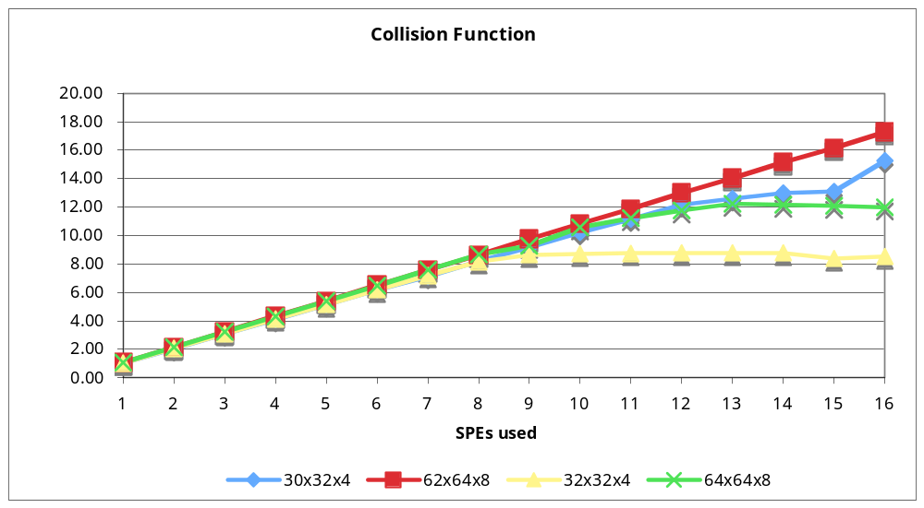
Cell Double Precision LBMHD Performance
Weak scaling (blade problem size increases with the number of SPEs used)
Sustain over 17GB/s
Without computation, attain 21GB/s
Performance penalties if not aligned (12GB/s)

Slide 39
Comparison
Architecture | GFlop/s
Cell Blade* | 17.25
Cell Chip* | 8.65
SX8 | 9.66
X1E | 5.65
Earth Simulator | 5.45
1.9GHz Power5 | 0.79
2.2GHz Opteron | 0.60
1.4GHz Itanium2 | 0.32
BGL Chip | 0.31
*Collision Only (typically 85% of time)

Slide 40
Conclusions
Cell shows a lot of promise for scientific applications requiring Double Precision arithmetic
Cell+ enhancement would further improve DP performance with modest architectural changes
Cell Performance is very predictable and understandable!
Given the current programming model and software tools, the effort required is impractical for large scale codes
  An “existence proof” is not a solution! (so curb your enthusiasm!)
  However, solving these problems is tractable and its what computer scientists are (and should) be doing!
  Not as contorted as GPU programming
  HW: Consider hybrid vector programming support and leverage existing vectorizing compiler technology (eg. ViVA2)
  SW: Consider “compiler magic” to make DMA programming as accessible as vectorization (eg. IBM Octopiler)
Notes:
Typical of our community: assume existence proof means the era of FPGA-computing or GPU computing has arrived! Well, its all a lot harder than that. However, cell is closer to being a tractable programming environment than the others because you can construct a vector or cache-like programming model in software.

